Slide 1
LECTURE: 7
PROBLEM SPACES AND SEARCH

Slide 2
What is Production System?
Framework for modeling complex problem-solving tasks.
consisting of:
Rules: Defined as condition-action pairs.
Memory: Tracks the system's current state.
Strategy: Determines rule application order.

Slide 3
Key Components of a Production System:
Knowledge Base: Stores rules and facts.
Inference Engine: Applies rules to facts.
Forward Chaining: Data-driven deduction of facts.
Backward Chaining: Goal-driven search for data.
Working Memory: Holds system's current state.
Control Mechanism: Manages rules and system flow.

Slide 4
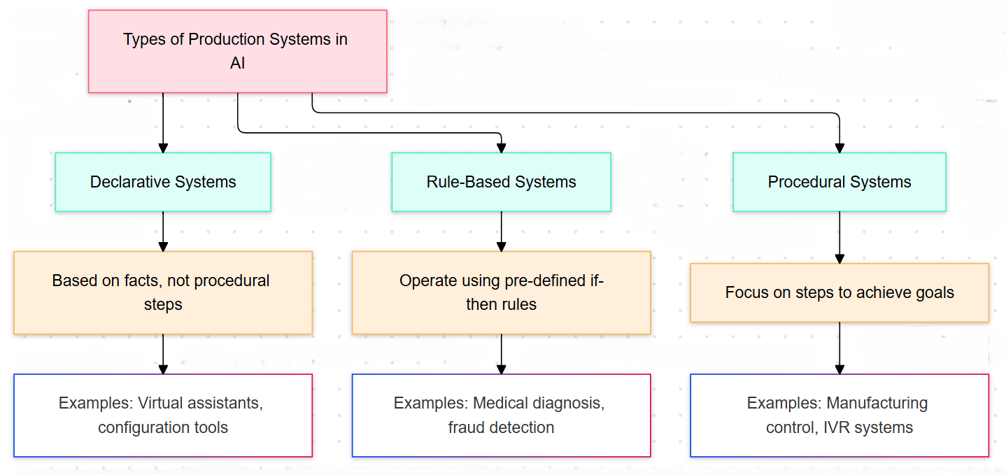

Slide 5
How Production Systems Function?
Match: Identify rules triggered by current facts.
Select: Choose a rule based on criteria.
Execute: Apply rule, updating working memory.

Slide 6
Production System Characteristics:
Monotonic Systems: Rules don’t stop other rules later.
Nonmonotonic Systems: Rules can block future rules.
Partially Commutative: Rule order doesn’t change the result.
Commutative Systems: Both monotonic and order-independent.

Slide 7
Characteristics of AI Problem Spaces
• AI problems have very large state spaces (e.g., Chess)
• Often involve uncertainty and incomplete information
• Environments may be dynamic and non-deterministic
• Problems are goal-driven and require intelligent search
• Heuristics are needed because brute force is impractical
• Require knowledge representation and reasoning
• Learning from experience is often necessary

Slide 8
Examples of AI Problem Spaces
Chess: Huge number of possible states, requires heuristic search
Autonomous Driving: Dynamic, real-time, uncertain environment
Medical Diagnosis: Knowledge-intensive with probabilistic reasoning
Route Planning: Optimal path search in large graphs
Recommendation Systems: Learning from user behavior data

Slide 9
Introduction to AI Workflow
Data Collection from real-world sources
Data Cleaning, Labeling, and Preprocessing
Feature Engineering and Representation
Model Selection
Training and Evaluation
Deployment of the trained model
Monitoring and Feedback for improvement

Slide 10
Data-Centric vs Model-Centric Approach
Model-Centric:
• Focus on changing algorithms and hyperparameters
• Performance depends heavily on model tuning
Data-Centric:
• Focus on improving data quality and labels
• Removing noise and bias from data
• Leads to better performance even with simple models

Slide 11
Challenges in AI Problem Solving
State space explosion in complex problems
Difficulty in representing real-world knowledge
Handling uncertainty and ambiguity
Data quality issues: noise, bias, insufficiency
Real-time decision-making requirements
Ethical issues and model explainability
Generalization from lab to real-world scenarios

Slide 12

Next: Navigating the Maze of Search Strategies!

